Slide 1
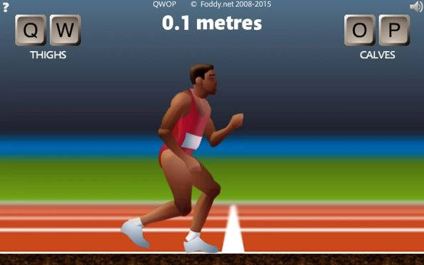
Model-based reinforcement learning for browser game QWOP using DreamerV2
David Guevara

Slide 2
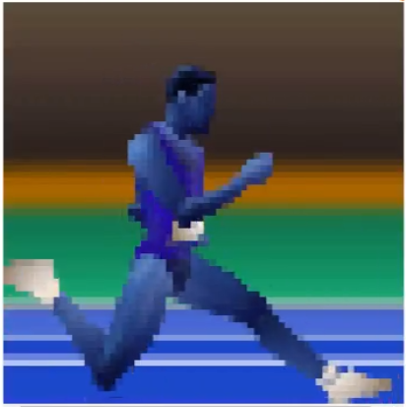
Background
DreamerV2 -> Master Atari games
Tested against Walker2D (MuJoCo)
Most games are not 8-bit games
Let's test how it does with a mix of both Atari and Walker2D
Make it get to the goal
- Reward
- Additional info:
- Position X, Y
- Torso angle
- Head angle
- Thighs angles
- Calves angles
- Terminal (T/F)
64x64 pixels

Slide 3
Algorithms
DreamerV2
Run prefill episodes
Understand how it works
Run training inside its "mind"
Test and adjust inner environment
Proximal Policy Optimization (PPO)
Model-free
Small steps within trust region
This makes it very stable

Slide 4
Methods
Environment – Calculate different rewards and return the current distance
DreamerV2 – Accept the state, reward, remember max distance per episode and log per episode
Proximal Policy Optimization – Remember max distance per episode and log per episode
Tested different rewards
Velocity
Torso angle * velocity
Velocity * distance
Distance

Slide 5
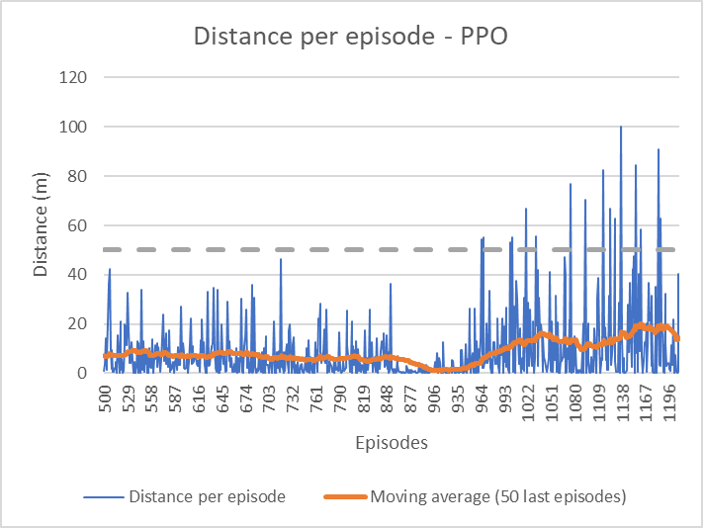
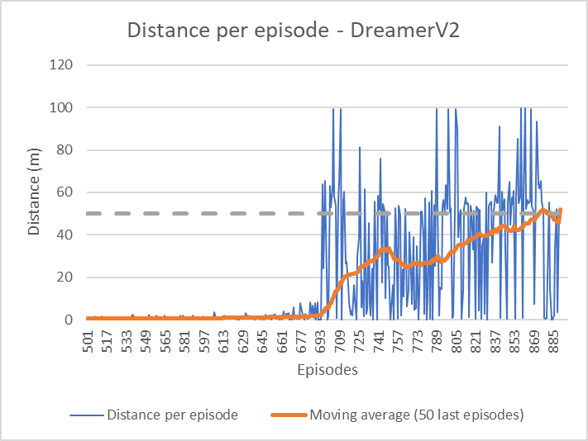
Findings
Algorithm | Max. avg. distance (m) (50 last episodes) | No. of victories in 1200 episodes | No. episodes for first victory | Max. avg. Reward (50 last episodes)
DreamerV2 | 52.078 | 7 | 704 | 0.015
PPO | 19.915 | 1 | 1208 | 0.154

Slide 6
In brief...
Summary
Trained Dreamer and PPO for QWOP
Everything was already built-> Put everything together
Conclusions
Velocity seems to be the only effective reward
50-meter mark -> checkpoint
DreamerV2 learned quicker
PPO prioritized mean velocity
DreamerV2 prioritized not having negative velocity

Slide 7
